Slide 1
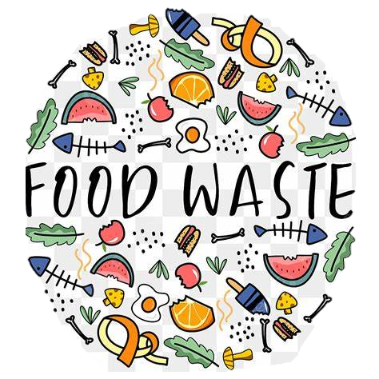
Food Waste
End the food waste war!
Why is food waste a problem? Food waste is a problem for everyone! People could be fed but we choose to throw out our food and creating greenhouse gases when we could feed others! Climate change is still a thing and food waste is only contributing to the growing problem of the planet.
How can the power of individual choice create a future without food waste?

Slide 2
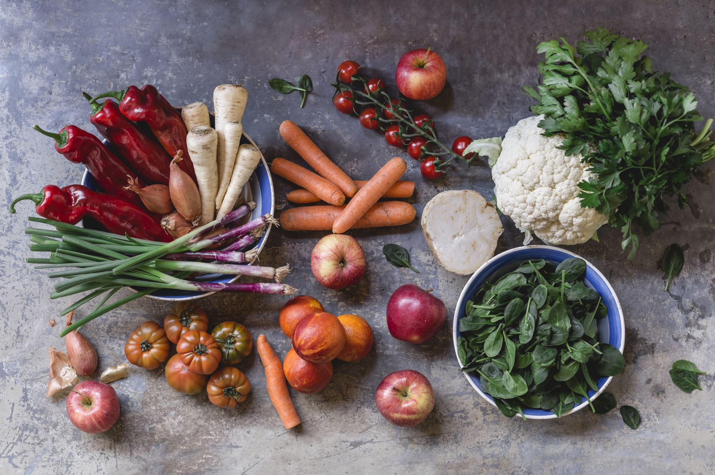
What is FEAST?
Feast is an Australian wide program fighting to reduce the amount of food waste Aussies are creating. Implementing this in schools is a great way to teach kids about the importance of FEAST and how food waste can be prevented.
-Teaching OzHarvest in school teaches unaware children of the benefits of using methods like composting or pickling so we can save our ozone from the dangers of food waste.
-Food waste is a common thing throughout the economy. But when you throw it out, do you realize the impact you're making a dint in the problem? You can have so many better solutions!
-This is a great way to encourage people that there's better ways to manage food waste!
Future generations can clean up the mess we made and help it from happening again.
Education In The FEAST Program!

Slide 3
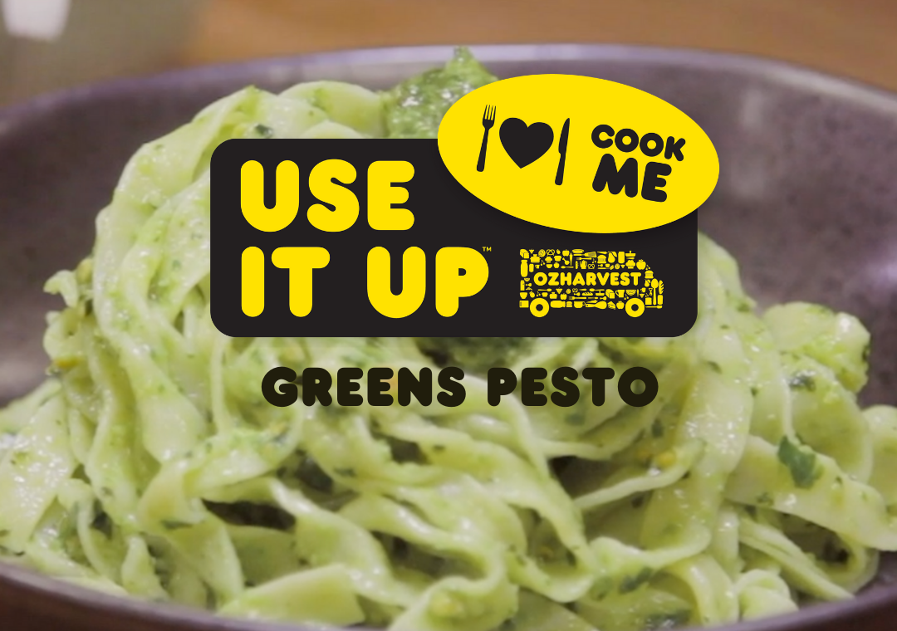
Use It Up!
Use it up is a strategy used by OzHarvest to promote food waste. It is telling us to use what we have and use only what we need. If you use it up, your reducing food waste and greenhouse gases in the air, meaning your saving the world and ozone layer!
How about try to make some recipes with some sad crisper vegetables? Or give a vegetable brownie a chance! Try to label your foods correctly. Use some OzHarvest tape to mark foods you need to eat now, save for later or even freeze your foods!

Slide 4
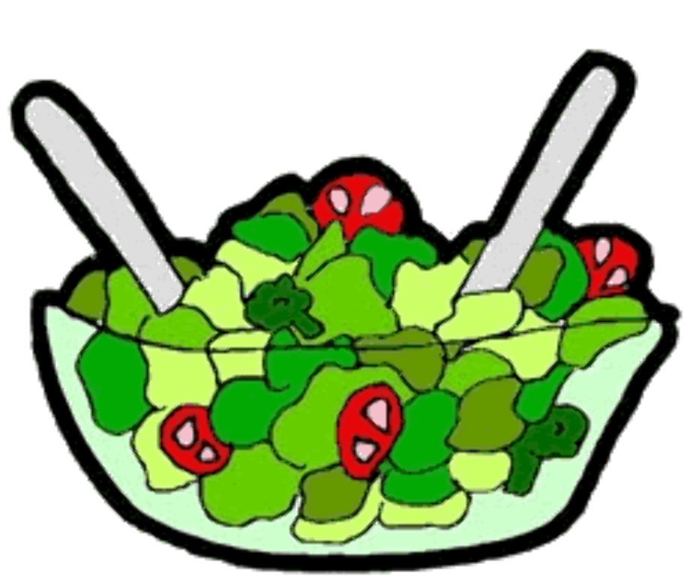
Maddy’s Magic Salad
5.
Cut your avocado into medium chunks.
(4 serves as a side)
1.
Cut your tomato into medium chucks.
-Avocado 1x ripe
-Tomato 1x
-Bread 1 quarter loaf
-cheese 2 cups
-Corn 2x cobs
- 100g of lettuce
-black beans 100g
- red wine vinegar.
-pepper/herbs of our choice.
1/2 a teaspoon of caster sugar
-1/2tbsp red wine vinegar
-Optional; Greek yogurt
6.
Take your lettuce and add to the bottom of the bowl before then adding black beans, tomato, corn and on top avocado.
2.
Remove the corn from the cob, then place in frypan on medium heat until golden/brown.
3.
Take your bread and rip it up finely, to create breadcrumbs.
7.
Lighting coat the dressing on top the salad.
4.
Mix your vinegar, oil, sugar, pepper and/or herb together to make a fine dressing.
8.
Mix the salad up until all combine before then sprinkling breadcrumbs on top.
-chopping board
-knife
-measuring cups AND spoons
-wooden/meatal spoon
-strainer
-frypan
9.
Enjoy! serve with any main meal you feel fits or enjoy the salad itself!

Slide 5
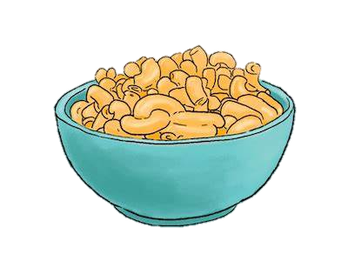
Abigail’s Magnificent Mac and Cheese
(Serves six)
1.
Fill your pot with lightly salted water and bring to a boil. Stir pasta in and return to a boil. Cook, uncovered, (6 to 8 minutes.)
5.
Drain pasta and add to the cheese sauce. Pour half of the macaroni and cheese into the prepared baking dish.
1 brown onion finely chopped.
1 clove garlic, crushed.
750g macaroni.
1 3/4 cup reduced fat milk.
1/2 cup wholemeal plain flour.
1 1/2 cup cheddar cheese, grated.
1/2 teaspoon ground black pepper.
2 tablespoon parsley, chopped,
A teaspoon of Butter
2.
Preheat the oven to 175 degrees. Lightly spray a 9x9 baking tray with oil.
5.
Toss in the remaining 8 tablespoons each of cheddar cheese into a small bowl then sprinkle half of the cheese mixture over pasta. Pour in remaining pasta into the dish, sprinkle remaining cheese mixture over the top.
3.
Melt butter in a saucepan over medium-low heat. Whisk in flour until no lumps remain. Pour in milk, whisking continuously. Whisk in, salt, and cook until thickened, (2 minutes.)
Large pot
Wooden Spoon
Oven
9x9 Oven Pan
Cooking Oil Spray
Saucepan
Strainer
Baking dish
4.
Add in the 1 cup of cheddar cheese, and stir until all cheese is melted, about 1 minute.

Slide 6
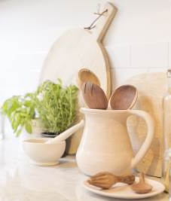
How can recipes like this tackle food waste?
Our recipes are using some of the most wasted food items in Australia! Cheese, bread, tomato. These are all foods wasted on insane quantity's each year. Our recipes are using some of these items and putting them in delicious dishes for the family to enjoy!
Our recipes are also super healthy! They are made of protein and iron filling items that will support your immune system! It’s a win-win!
When you’ve baked our delicious food fighting dishes, you might have some leftovers. How about putting them in your fridge with some OzHarvest tape and have for your lunch tomorrow? Or place in a PLASTIC container and freeze for another night.

Slide 7
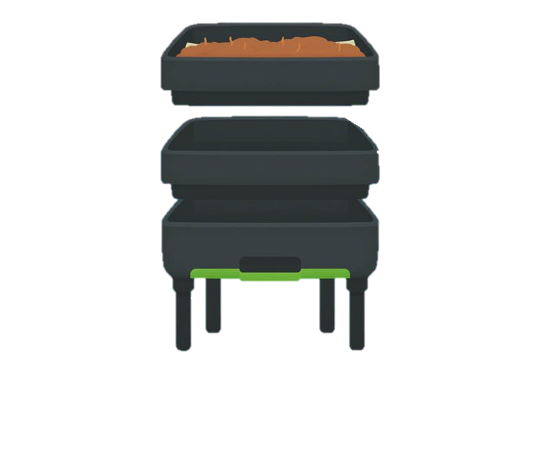
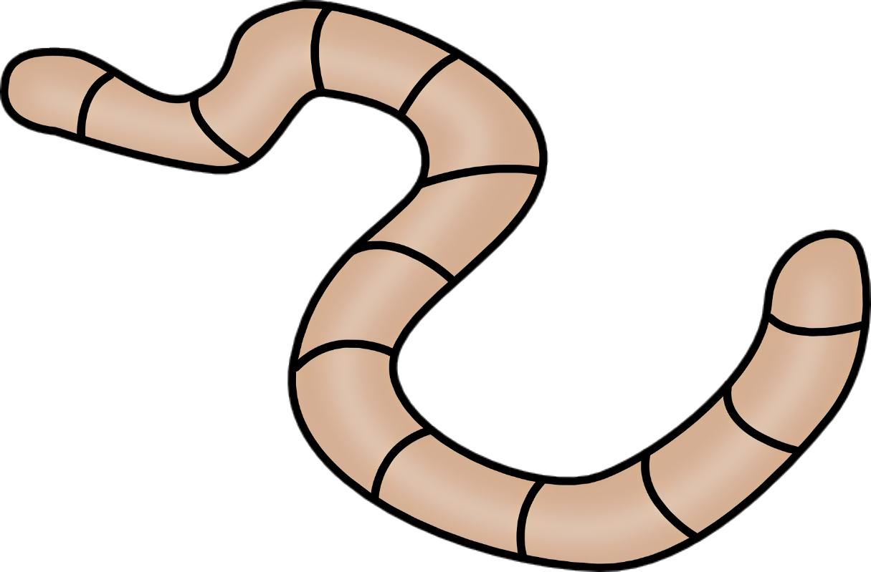
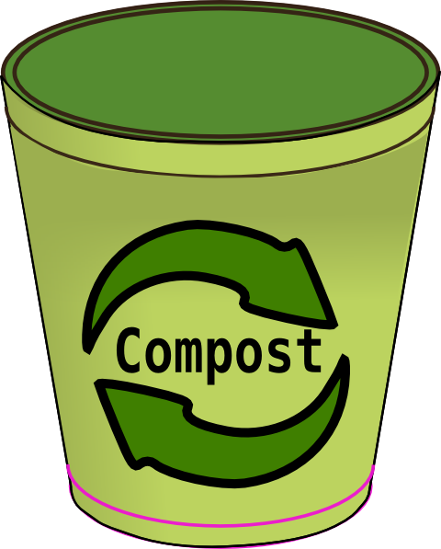
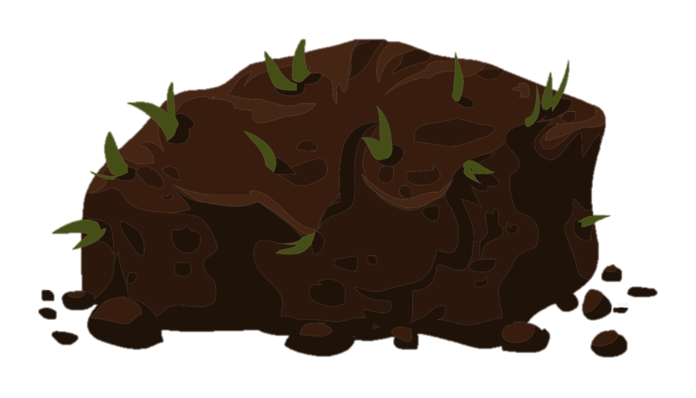
Worm Farms! (definition)
Make vegetable matter or manure into compost
Got a spare banana peel? Throw it in with the worms to get healthy soils for your garden!
The worms eat it up. (yum-yum!) Then then reproduce it and produce liquids and a fertilizer like substance for your garden. Later you get a healthy soil like thing for your garden.
It minimizes wasteful products and saves landfill space by recycling organic matter.
It improves soil health, and water retention by adding nutrients and organic matter.
It reduces greenhouse gases and fights climate change by preventing methane production from landfills.
It creates green jobs and supports local communities by providing a valuable soil replacement.

Slide 8
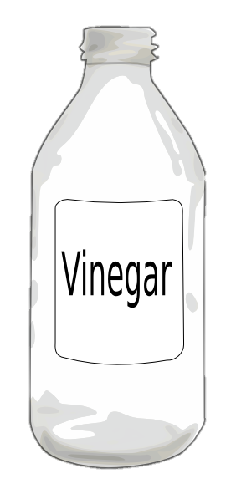
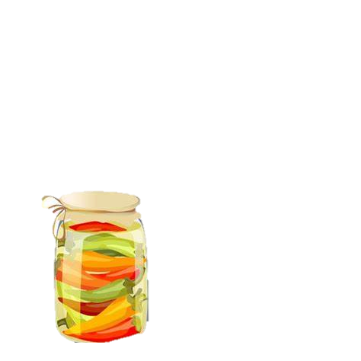
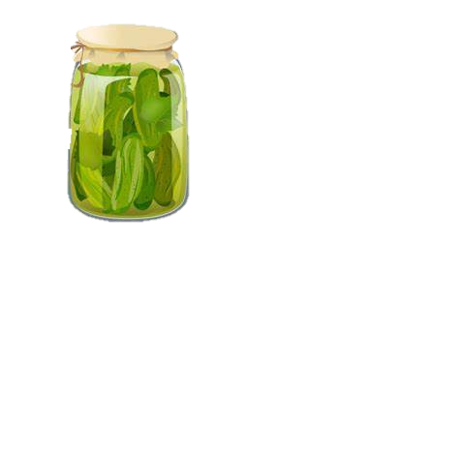
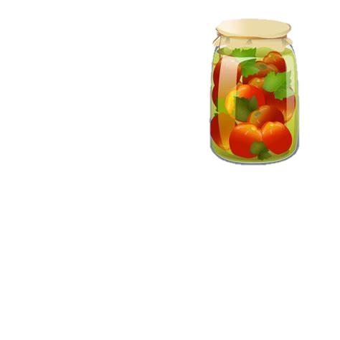
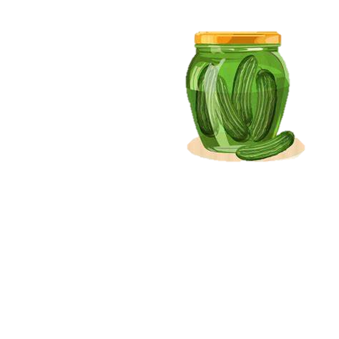
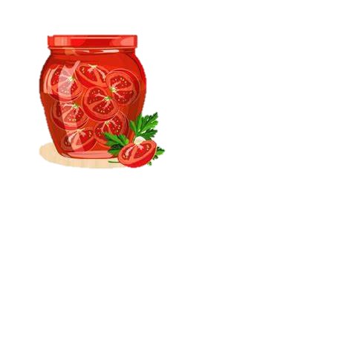
Pickling (definition)
Suitable for being pickled or used in making pickles
You got a spare cucumber or carrot?
Well, use it up! Throw it in a part water and vinegar mixture (with herbs of your choice) and pickle it for a few days for the perfect sandwich topping or lunch side.
You can basically use any vegetable as well!
Carrot
Cucumber
Capsicum
Tomato
Chili
Celery
ext.
-Some benefits to pickling include:
-Longer shelf life
-Added flavor and taste
-Simple and easy
-Teaches kids basic skills in the kitchen
-Inexpensive.

Slide 9
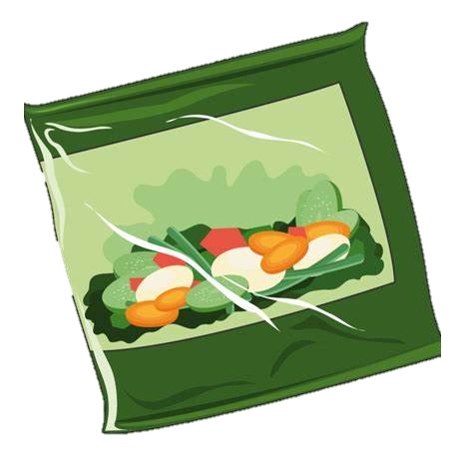
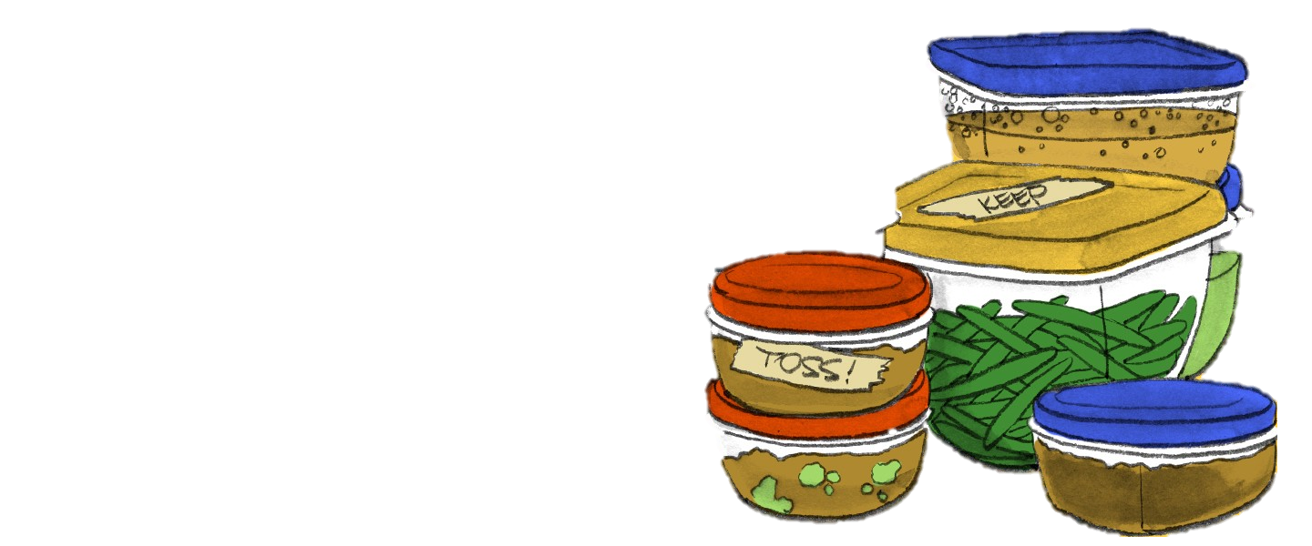
Freezing Leftovers.
I know we have all thrown out that half-eaten banana or that perfectly good dinner from last night, but why? When you throw out perfectly good food like that you're contributing TO the problem. Wait, how could I prevent this? I'm not going to use this. Well, you could try freezing it! Freezing leftovers and half used foods is a perfect way to preserve their freshness and increase shelf life!

Slide 10
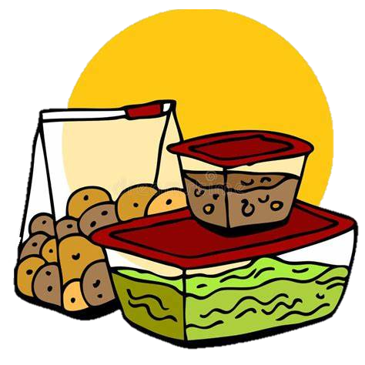
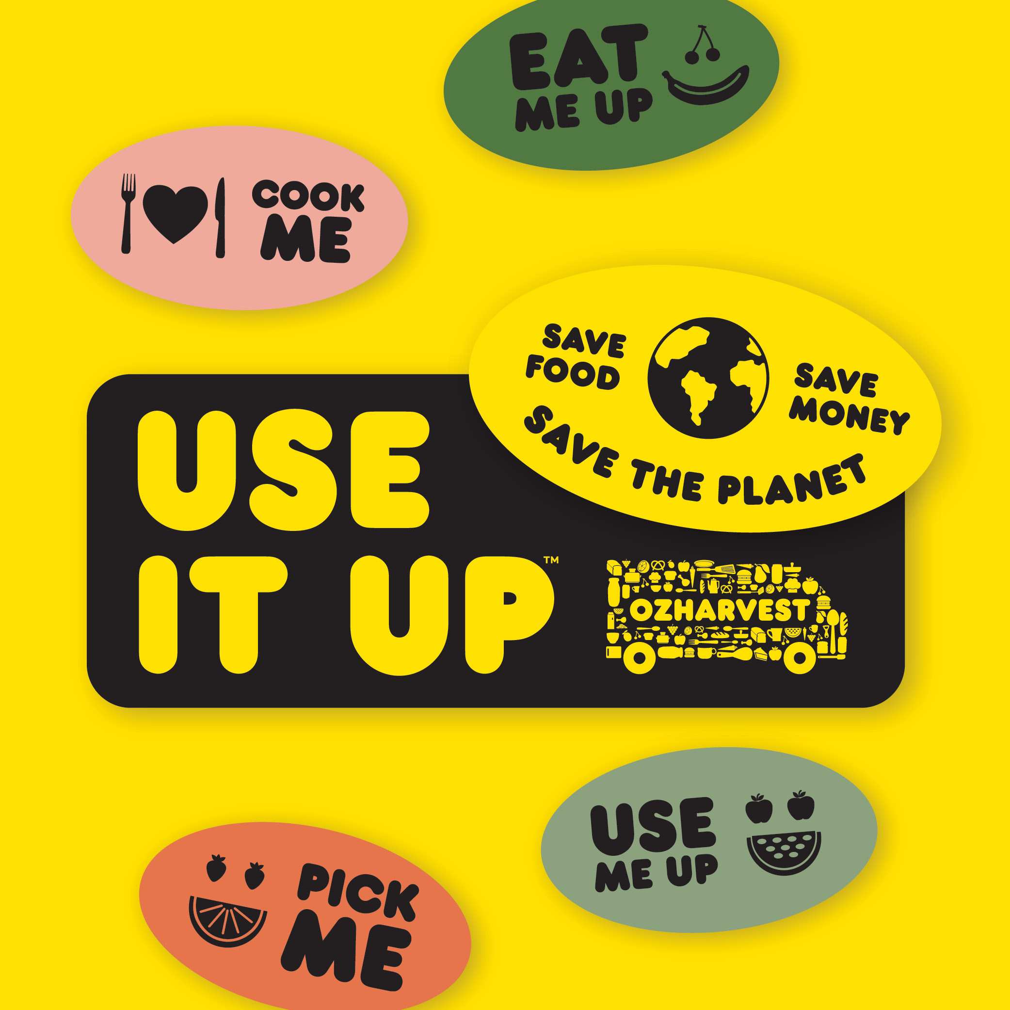
Food waste is preventable! So why don’t we all do something? With the power of individual choice, let us all create a future where we don’t have to worry about global warming. Where we don’t have to throw out any perfectly good foods! Create a new future.
Here is a brief breakdown of the solutions in this power point.
Freezing leftovers.
Pickling foods.
Education in the FEAST program.
Use It Up!
Worm farms.

