Slide 1
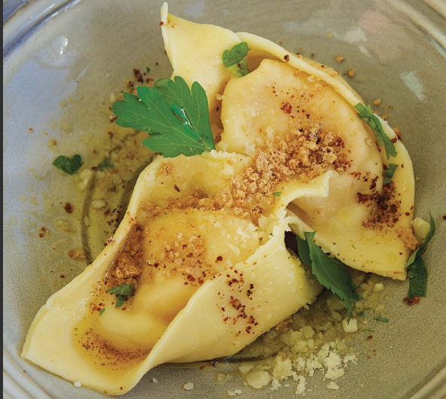
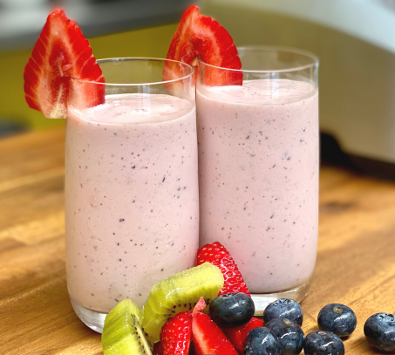
OZHARVEST
FEAST PROGRAM
-FIGHT FOOD WASTE PROMO-
+
+

Slide 2
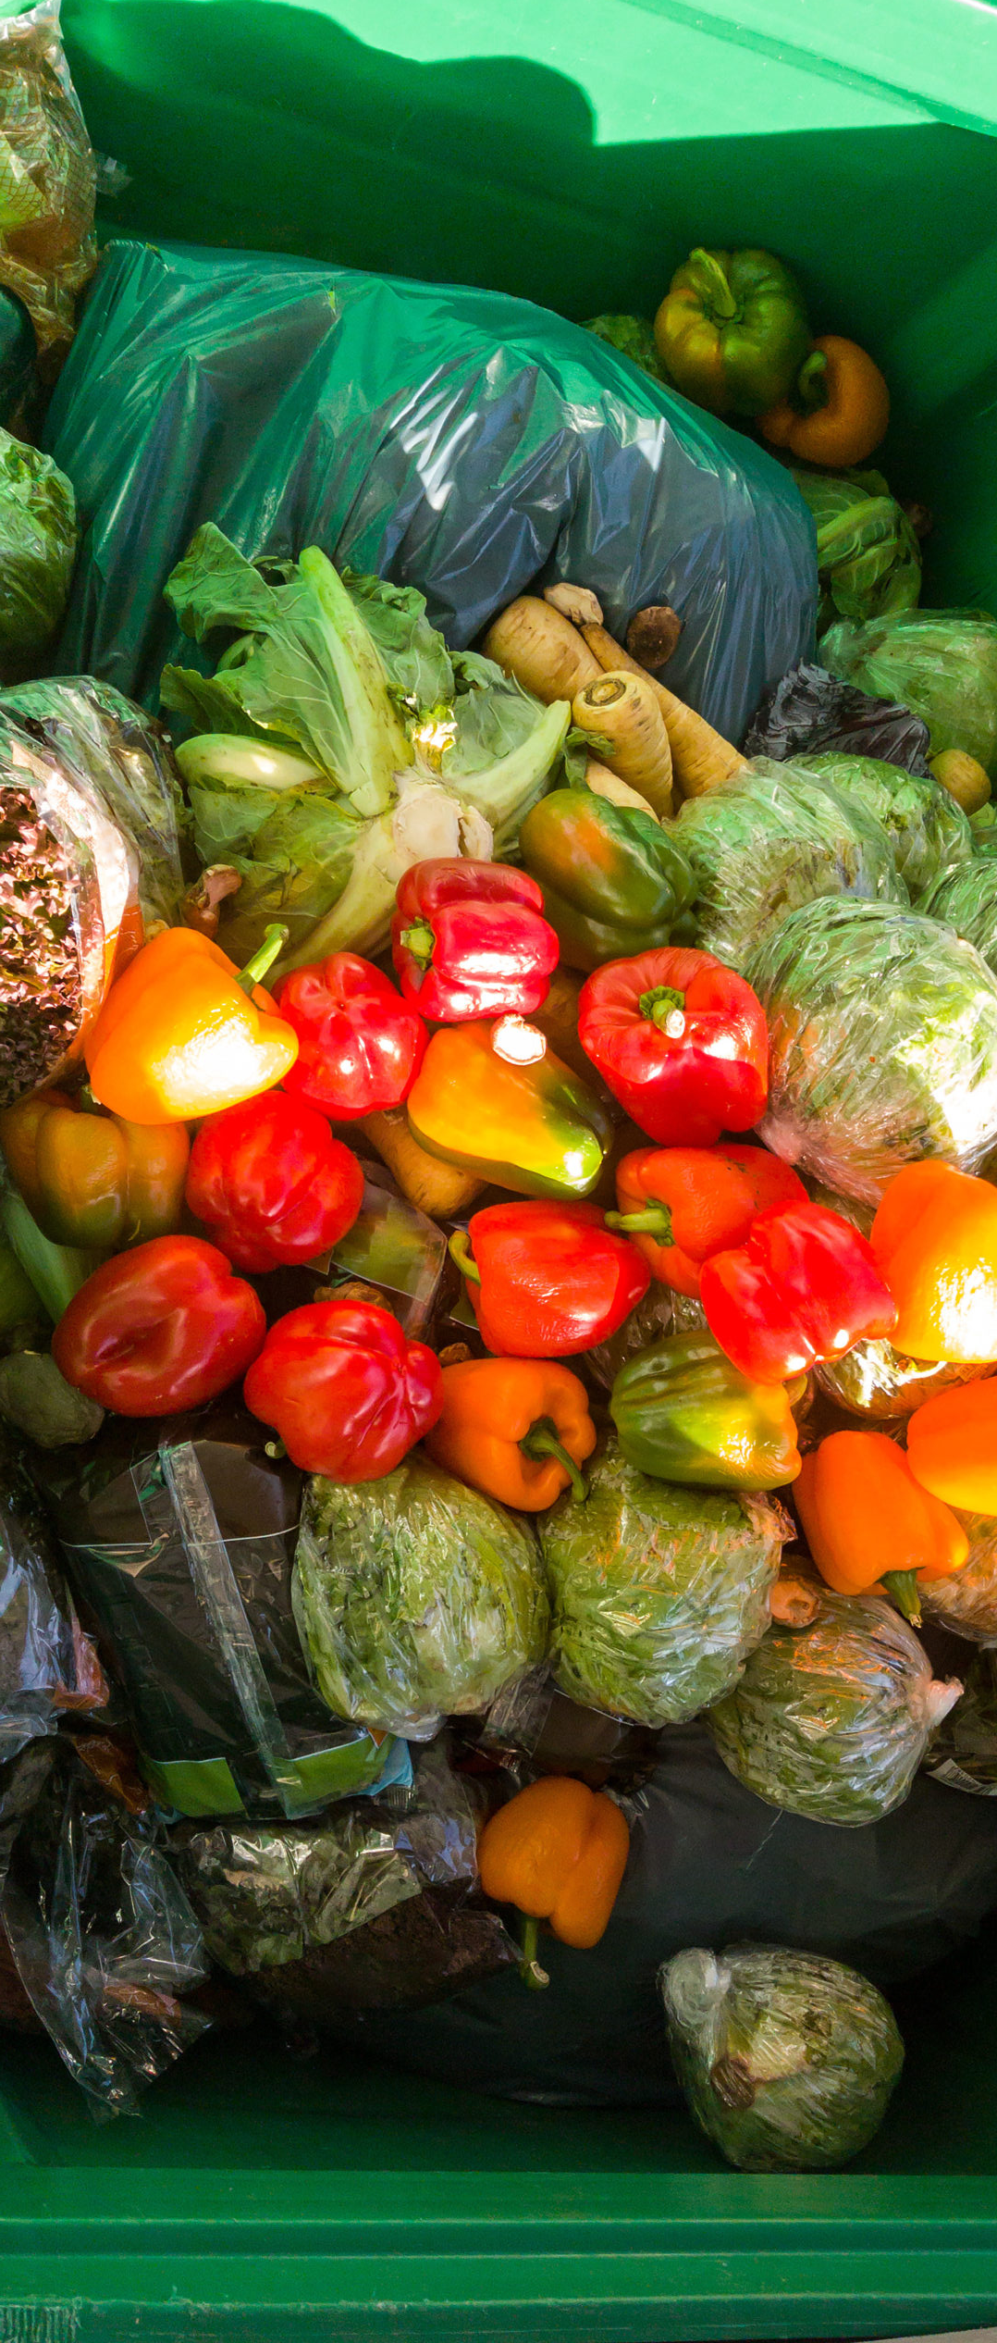
FIGHTING FOOD WASTE–
WHAT IS FOOD WASTE AND WHY IS IT A PROBLEM?
Food waste is uneaten or unused food that is thrown away unethically into landfills across the world. This happens to a whole third of all food produced in Australia, meaning we lose millions of tonnes of perfectly edible foods annually. The top six foods that are wasted in Australia are (in descending order): Meat (543, 000 tonnes), Cheese (331,000 tonnes), Milk (230,000 tonnes), Tomatoes (197,000 tonnes), Bread (186,000 tonnes), and Apples (43,000 tonnes). And majority of leftovers from meals and older fruits/vegetables are also discarded for newer fresher produce, which happens rather often in the average household.
This largely contributes to food waste in Australia, but you may be asking the questions, ‘Why does it matter if we’re just simply throwing out the food?’ or ‘Doesn’t food decompose faster than most plastics though?’. Well, when food waste is put in landfill, it releases a toxic gas, methane, which is 3x stronger and more dangerous than carbon dioxide. The methane harms the environment and the atmosphere, adding to the struggle of global warming and its whole ‘wave’ of issues.

Slide 3
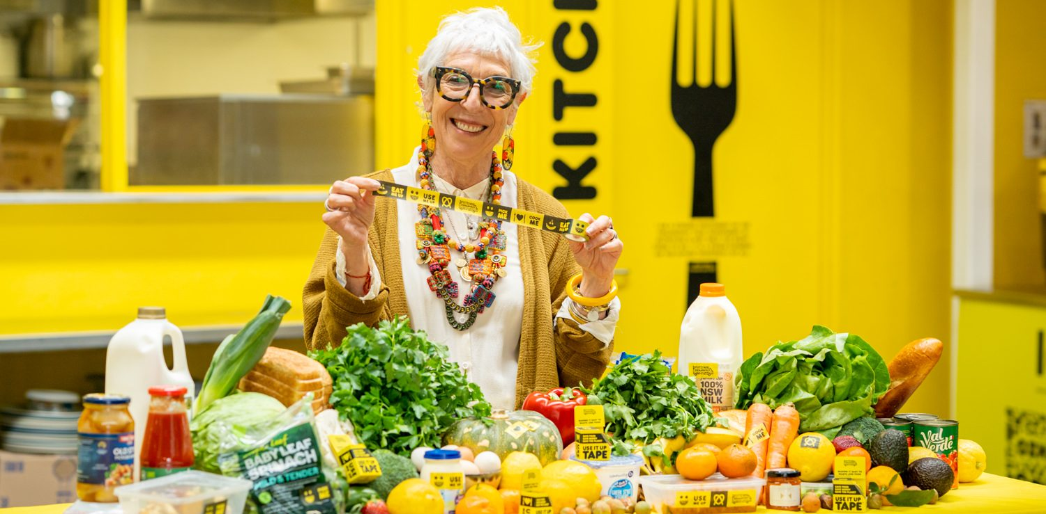
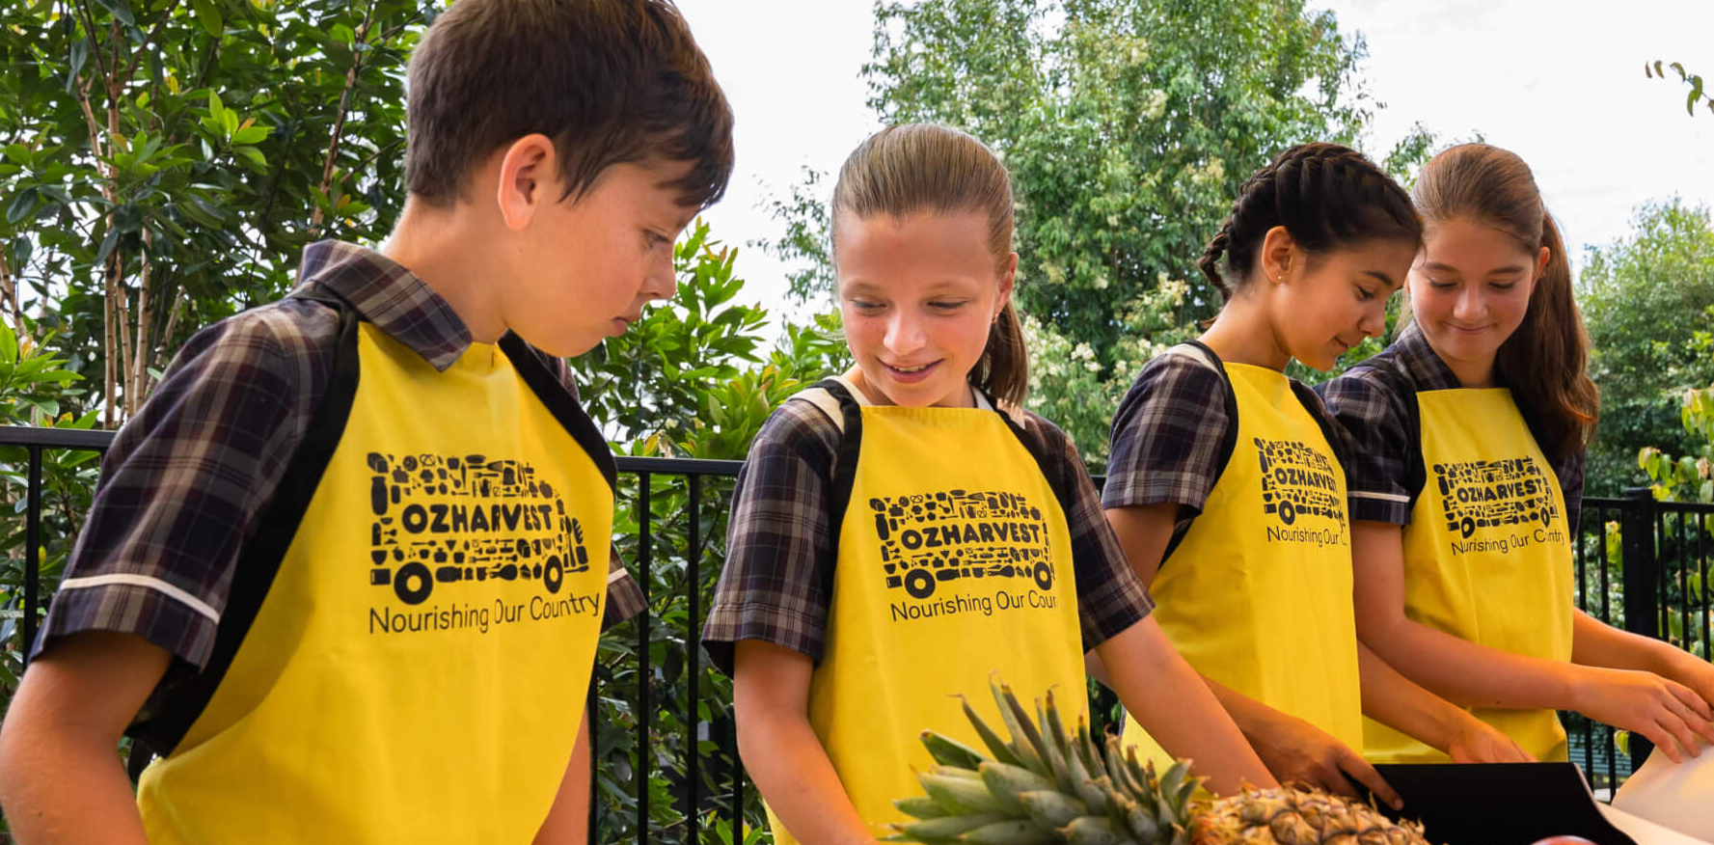
FIGHTING FOOD WASTE-
‘EDUCATION’
-WHAT-
- The ‘EDUCATION’ strategy refers to FEAST, an Oz Harvest run program dedicated to teaching adolescents basic cooking skills and the impacts that food waste has on the environment.
-WHEN-
- The ‘FEAST’ lessons would be conducted during class time as an assessed program that tests students on their knowledge and understanding of food waste and their cooking skills.
‘95% students know how to reduce food waste,
85% students are confident in cooking healthy recipes,
75% students say that they ate more fruit and vegetables’
(Oz Harvest ‘FEAST’ website: Home | OzHarvest FEAST)
-WHO-
- The main audience for ‘FEAST’ lessons are adolensts in high school which is during the age when learning cooking skills are most important and developing and beginning healthy food waste habits.
-HOW-
- To help fight food waste using the ‘EDUCATION’ strategy, you must be educated by a trained educator on the basic kitchen safety practices and skills that will be needed when cooking. Students will also learn of the importance of preventing food waste and learn strategies to help reduce the amount.

Slide 4
FIGHTING FOOD WASTE-
‘USE IT UP!’
-WHAT-
- ‘USE IT UP’ is an Oz Harvest made series of recipes that allow the reader/chef to incorporate the six most wasted foods in Australia into healthy and nutritious meals.
-WHEN-
- Either in the home economic classrooms or the school provided kitchens, or at the student's house. Or in any hygienic and practical environment.
We got leftovers,
We got kitchens,
We stay hungry,
Use it up!
Put in the work
Put in the hours
We reduce food waste!
(Parody of Dwayne ‘the Rock’ Johnson’s part in ‘Face Off’)
-WHO-
- Anyone with the basic understanding and skills to cook and clean in a kitchen environment would be able to follow the instructions in the recipe, though I must recommend that children under 13 to be supervised by a responsible adult.
-HOW-
- To help fight food waste using the ‘USE IT UP’ strategy, you simply must take note of what ingredients you currently own in your fridge, freezer or cupboard and follow the chosen recipe. This helps fight food waste by using up ingredients that otherwise would contribute to global warming.

Slide 5
RECIPE 1 –
LAMBASTE POULTRY RAVIOLI
HOW DOES THIS RECIPE REDUCE FOOD WASTE?
‘Lambaste Poultry Ravioli’ helps reduce food waste by using two of the most wasted foods in Australia; Meat (543, 000 tonnes) and Cheese (331, 000 tonnes), that would have otherwise gone to landfill, and making them into a delicious and nutritious meal to enjoy.
CHOSEN COMMONLY WASTED FOOD: MEAT AND CHEESE
RECIPE NAME: EASY ROAST CHICKEN RAVEOLI/LAMBASTE POULTRY RAVIOLI
PREP TIME: 10 MINUTES COOK TIME: 10 MINUTES SERVES: 4
INGREDIENTS:
- 1 packet wonton wrappers
- 200g leftover roast chicken
- 150g fresh ricotta
- 30g grated parmesan
-pinch of grated nutmeg
-1/2 bunch basil, finely chopped
-30ml olive oil
-freshly cracked, black pepper
-1 egg, whisked
-grated parmesan and olive oil to serve
EQUIPMENT:
- 1 cutting knife
- 1 medium sized metal/glass bowl
- 1 large sized metal/glass bowl
-1 wooden spoon or spatula, suitable for mixing.
- 1 cooking brush
- A stove or a gas top stove
- 1 colander
- plates and cutlery for serving
STEPS/METHOD:
5. Drain the water using the colander and serve dressed with olive oil,
parmesan and cracked pepper (a nice pesto is also recommended if you have one).
4. Bring a large pot of salted water to the
boil then reduce to a light simmer.
Drop in the ravioli and cook until tender,
around 3 minutes.
2. Mix ingredients together thoroughly and roll out into 20 even sized balls
of around 20 grams each and let sit in the
fridge to firm.
3. Lay out 20 wonton wrappers
and brush lightly with whisked egg. Place
a ball on top of each wrapper and cover
with another wrapper. Seal the edges
well, ensuring no air is trapped within.
1. Finely slice the chicken and place
into the bowl with the ricotta, parmesan, nutmeg,
basil, pepper and olive oil.

Slide 6
RECIPE 2 –
FRUIT PLATTER SMOOTHIE
HOW DOES THIS RECIPE REDUCE FOOD WASTE?
‘Fruit Platter Smoothie’ helps reduce food waste by using two of the most wasted foods in Australia; Dairy Products (543, 000 tonnes) and Fruits (331, 000 tonnes), that would have otherwise gone to landfill, and making them into a delicious and nutritious smoothie to enjoy.
CHOSEN COMMONLY WASTED FOOD: DAIRY PRODUCTS AND FRUIT
RECIPE NAME: FRUIT PLATTER SMOOTHIE
PREP TIME: 5 MINUTES COOK TIME: 5 MINUTES SERVES: 2
INGREDIENTS:
-Leftover fruit salad or platter
-Yogurt
-Milk
-Honey (optional)
EQUIPMENT:
-Blender
-Medium sized tray
-Baking Paper
-Freezer
-Plastic bags or containers
-Spoon
-Measuring Cups
-Serving cups
STEPS/METHOD:
4. If it’s too thick, just add a bit more milk and for extra sweetness, add a little honey. Enjoy!
2. Once frozen you can either store in bags or containers and keep for another day, or pop it straight in the blender.
3. Use as much fruit as you like, add a large spoon of yoghurt and cover 3/4 of fruit with milk. Blend until smooth.
1. Freeze your leftover fruit by spreading it on a flat tray lined with baking paper – this is the best way to avoid it turning into a big ice block, which you don’t want!

Slide 7
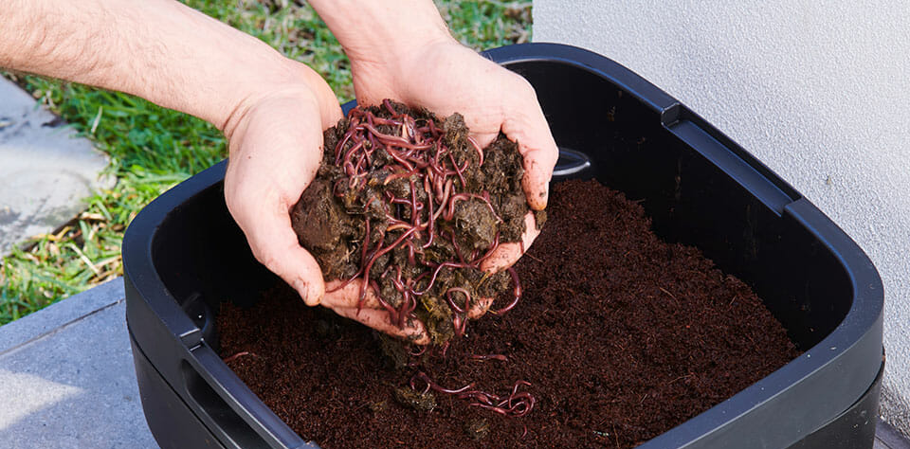
FIGHTING FOOD WASTE-
‘WORM FARMS’
-WHAT-
- ‘WORM FARMS’ are a strategy to reduce food waste that involves very little effort. Worms break down the food waste to produce healthier and richer soil for your gardens
-WHEN-
- ‘WORM FARMS’ are often made at home or in a school environment to reduce the amount of food scrapes that are going into waste. However, it is recommended not to create your worm farm in Winter due to most worms hibernating within the soil.
‘1. Put a couple of sheets of newspaper in the layer where the worms will live to prevent them from falling through.
2. Add bedding material such as cow manure, sawdust or coconut fiber, so the worms feel comfy in their new home.
3. Add the worms! You could buy a box of worms from your local hardware store or perhaps start off with just a handful from a friend's worm farm. Spread them out over the bedding and cover with moistened newspaper or moistened hessian.
4. Let them settle in for a week or so before you begin feeding them.
5. Store the worm farm in a cool place out of the sun because they really need a constant temperature.’
‘Building a Worm Farm’ ABC NEWS
-WHO-
- To assemble your worm farm, I would recommend a mature and strong teen or an adult, afterwards majority of people in different age groups would be able to benefit from having a worm farm.
-HOW-
- To help fight food waste using the ‘WORM FARMS’ strategy, you must first build a safe and stable shelter to protect the worms and soil from the harsh weather conditions. Afterwards, you simply need to occasionally change the soil, but you would have a functioning way to put your food scrapes ethically.

Slide 8
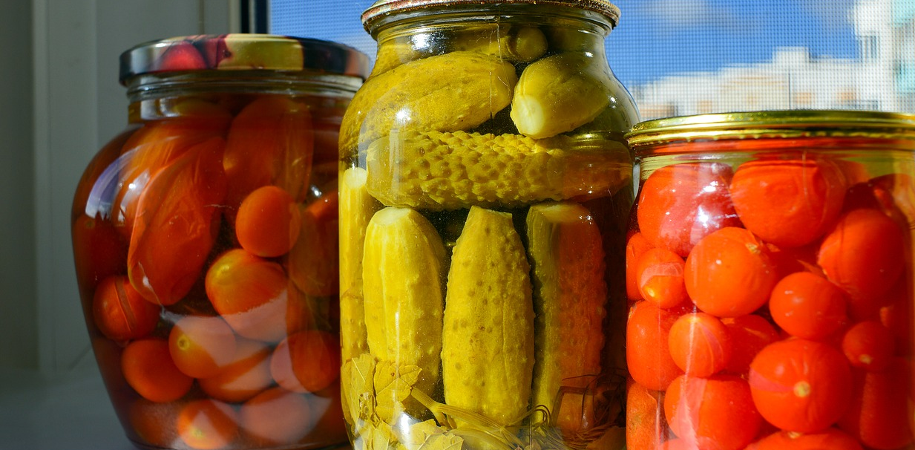
FIGHTING FOOD WASTE-
‘PICKLING’
-WHAT-
- ‘PICKLING’ is a process to preserve fruits and/or vegetables in a jar of vinegar for long periods of time to elongate their traditional shelf span while giving them a delicious flavor.
-WHEN-
- ‘PICKING’ is a simple strategy to reducing food waste and can be done practically anywhere or when as long as the chef is confident and is able to follow basic instructions.
‘Pickling is thousands of years old. Cucumbers were first pickled in the Tigris Valley in 2030 B.C.’
‘Cleopatra claimed pickles made her beautiful.’
‘It takes almost 4 billion pickles stacked end to end to reach the moon.’
-WHO-
- Anyone with the basic understanding of English and above the age of 8 would be able to learn and grow their ability to pickle using instructions. It is recommended for younger children for them to be supervised by an adult.
-HOW-
- To help fight food waste using the ‘PICKLING’ strategy, you must simply create the ‘mixture’ of different liquids and pour them into a jar with herbs and the selected fruits/vegetables. This helps fight food waste by prolonging the original shelf span of the fruits/vegetables.

Slide 9
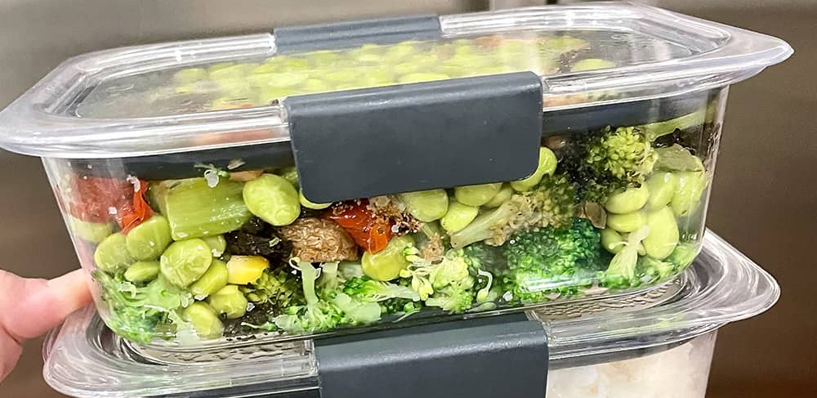
FIGHTING FOOD WASTE-
‘FREEZING LEFTOVERS’
-WHAT-
- ‘FREEZING LEFTOVERS’ is a strategy to help elongate the shelf span of your precooked meals (aka leftovers) by freezing them to prevent bacteria or mold from growing.
-WHEN-
- Either in the home economic classrooms or the school provided kitchens, or at the student's house. Or in any hygienic and practical environment. However, it needs to be stored in a freezer to preserve it.
‘Conducting a quick fridge temperature test with a thermometer is a smart idea to ensure your highly perishable foods (including leftovers, but also raw meat, dairy, fish, and produce) are being kept at a temperature that is cold enough to ward off potentially harmful bacterial growth.
Also, avoid keeping any of the above in the door of your fridge, as this is the warmest place in the refrigerator. Leftovers should be stored on a top or middle shelf towards the back—just make sure they're within sight so you don't forget to eat them until it's too late.’
‘How Long Your Leftovers Are *Actually* Good For’ -wellandgood.com
-WHO-
- Majority of people over the age of 10 would be able to learn and perform this strategy with easy, but again, it is recommended for children to be monitored by a trusted adult.
-HOW-
- To help fight food waste using the ‘FREEZING LEFTOVERS’ strategy, you must select whatever leftovers you will not be eating in anytime soon and freeze them. The difficulty depends on if the leftovers are full of ‘moisture’, and if so, this makes the freezing process much easier. So, when you are hungry for lunch, don’t waste fresh ingredients to make another meal, use the leftovers you froze!

Slide 10
FIGHTING FOOD WASTE–
CONCLUSION
So how will you reduce food waste?
You could reduce food waste by using one of the 5 strategies listed:
USE IT UP recipes, that use up foods in your kitchen that would otherwise contribute to the global issue of food waste.
FEAST education, to educate students on ways to reduce food waste by using cooking skills and fulfilling tasks or recipes to prove that they are successful in doing so.
Composting, ‘recycling’ your food waste and making healthier and better soil for your gardens and other flora projects.
Pickling, for prolonging the shelf life and changing the flavour of certain foods, generally fruits or vegetables.
Freezing Leftovers, for prolonging the shelf life of your leftover meals so you can have a delicious meal available without having to use your fresh ingredients.
By using these strategies and others to reduce food waste, you are reducing the amount of methane that is destroying our planet by using up healthy foods that would have otherwise gone to landfill.

